Slide 1
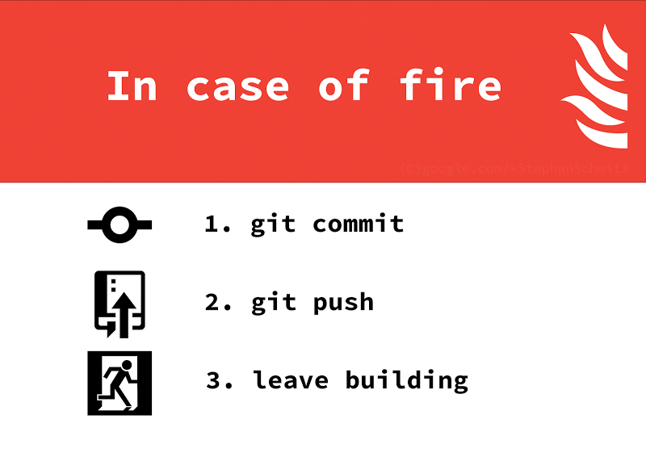
Version Control Using Git
Lab 4 – CSCI 3308

Slide 2

Version Control – Lingo
Advanced Actions
Setup
Source Control
Repository
Server
Client
Working Copy
Trunk / Main
Branch
Diff
Merge
Conflict
Resolve
Actions
Add
Check out
Check in / Commit
Check in message
Change log
Update
Revert
Revision

Slide 3


Slide 4
Git Basics

Slide 5
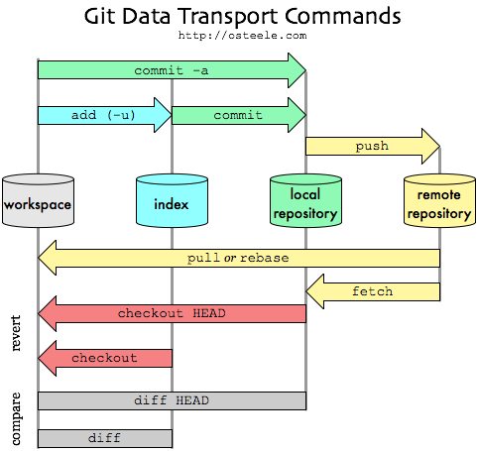

Slide 6
Remote Repo
pull
clone
push
Local Repo
commit

Slide 7
Staged Commit

Slide 8



Staged Commit
Revision 1
Modified
Staged
Revision 2
Modify
Add
Commit

Slide 9
Git Workflows
From https://www.atlassian.com/git/workflows

Slide 10
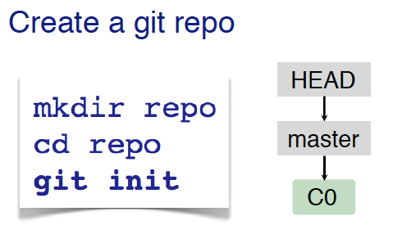
Workflows

Slide 11
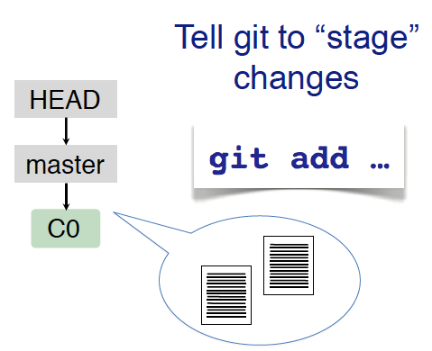
Workflows

Slide 12
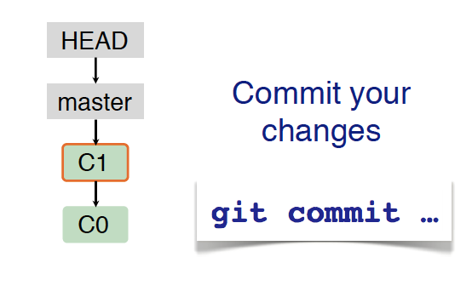
Workflows

Slide 13
Branches are a part of your everyday development process.
When you want to add a new feature or fix a bug—no matter how big or how small—you spawn a new branch to encapsulate your changes.
Branching & Merging
And allows your team to work on the same files in parallel!
This makes sure that unstable code is never committed to the main code base, and it gives you the chance to clean up your feature’s history before merging it into the main branch.

Slide 14
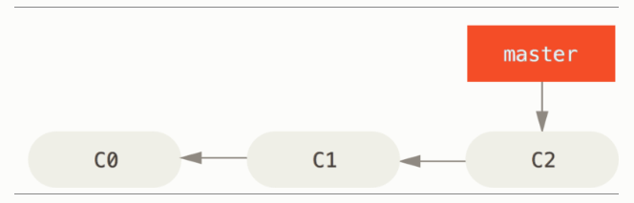
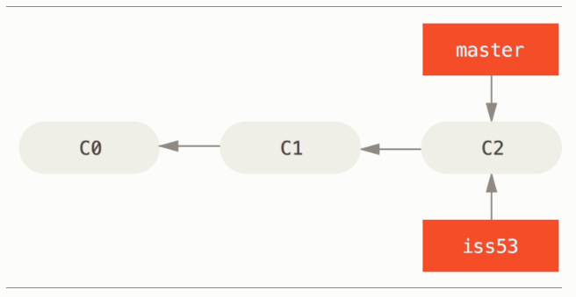

Slide 15
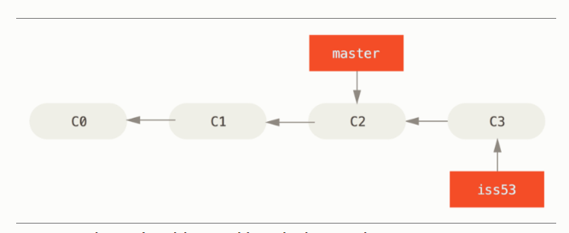
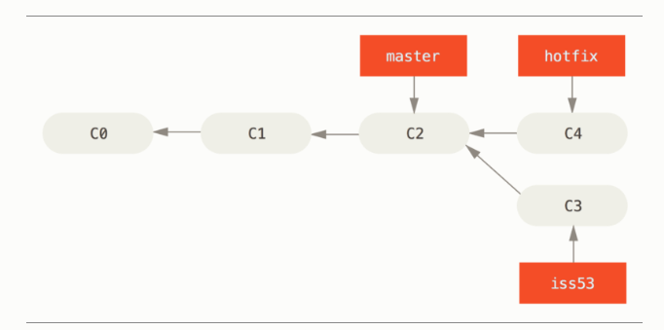

Slide 16
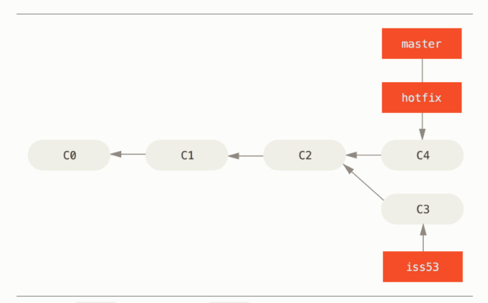

Slide 17
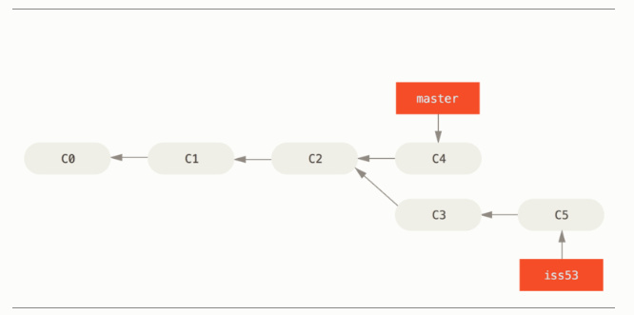

Slide 18
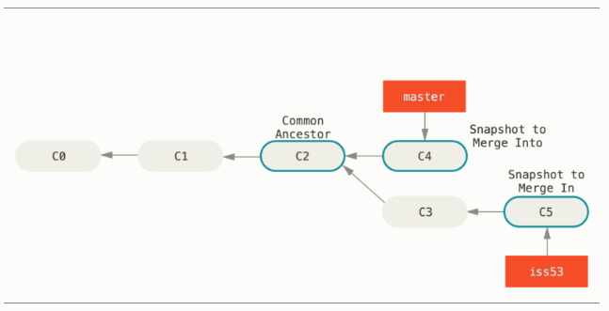
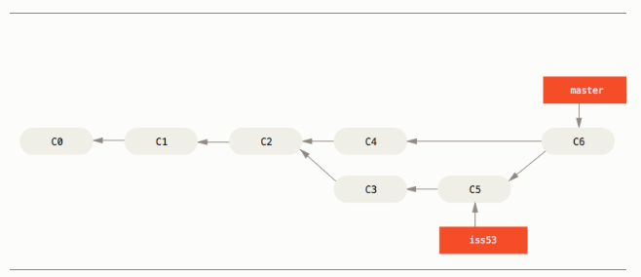

Slide 19
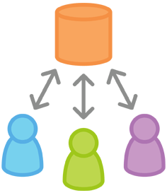
What happens when Collaborating?

Slide 20
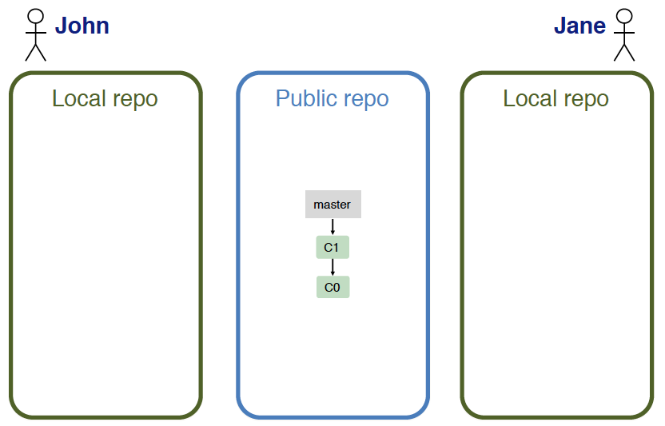

Slide 21
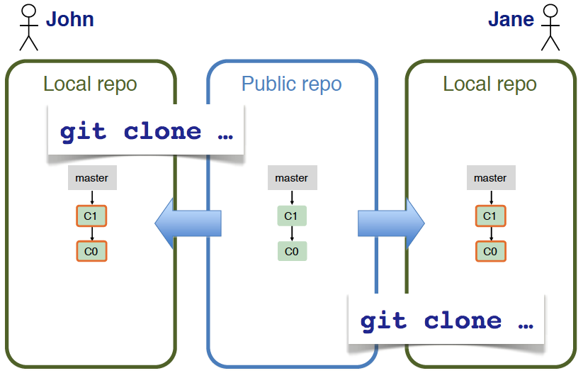

Slide 22
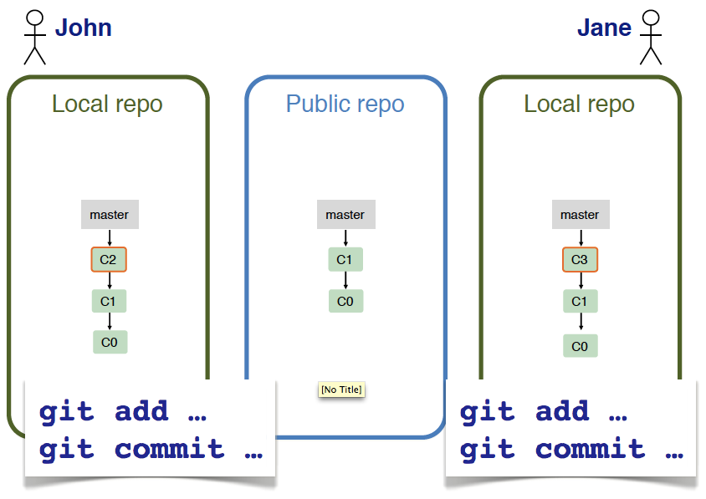

Slide 23
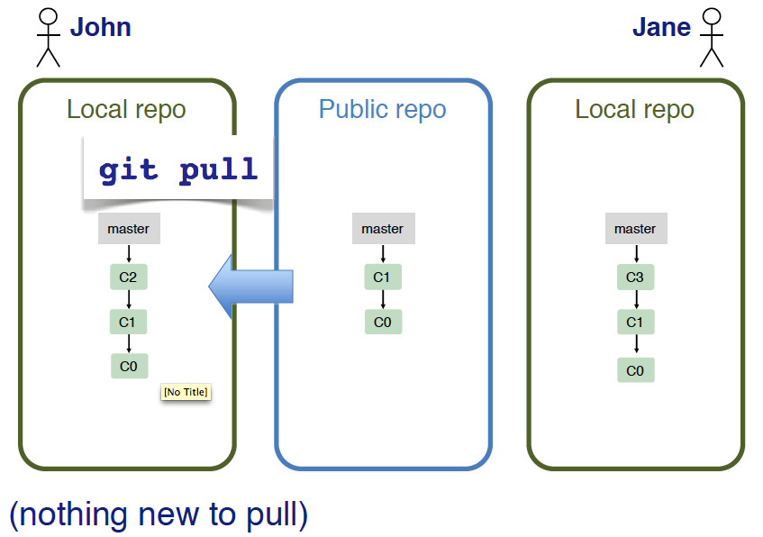

Slide 24
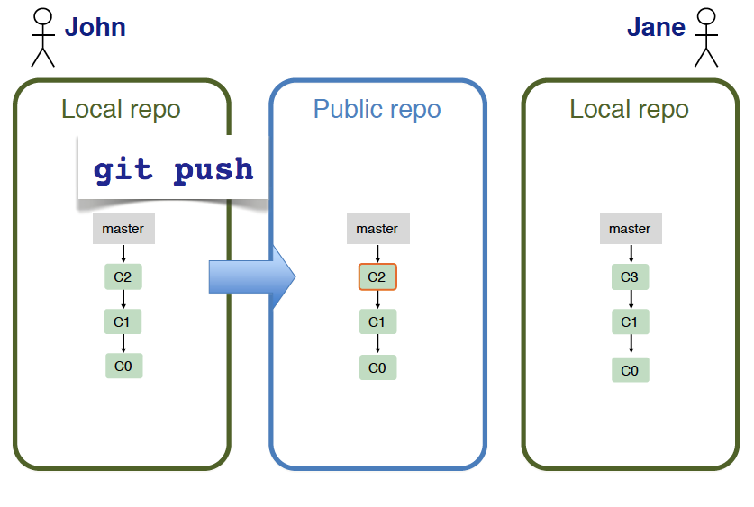

Slide 25
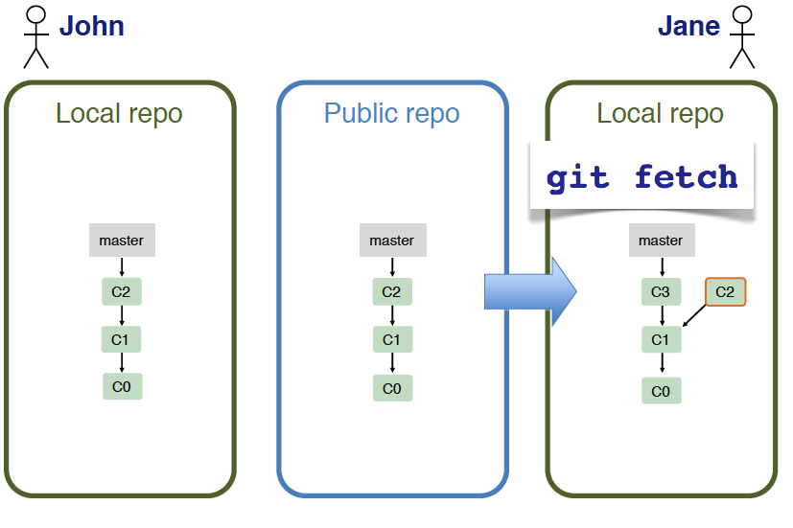

Slide 26
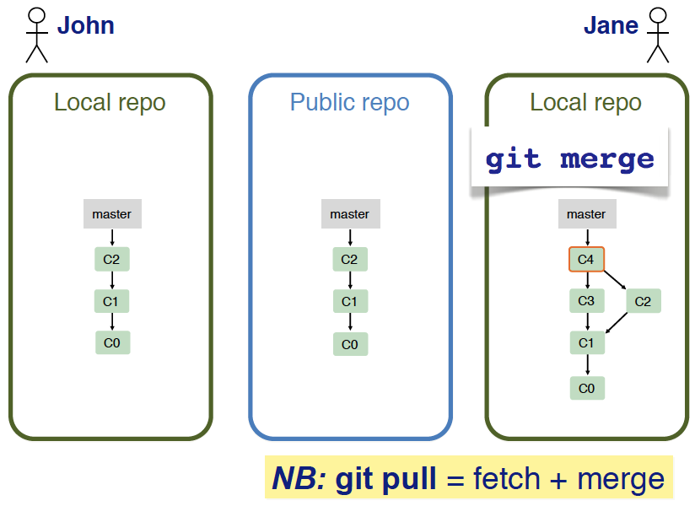

Slide 27
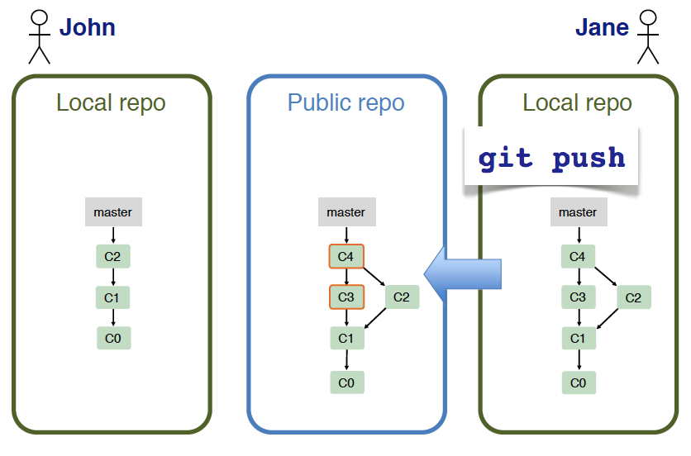

Slide 28
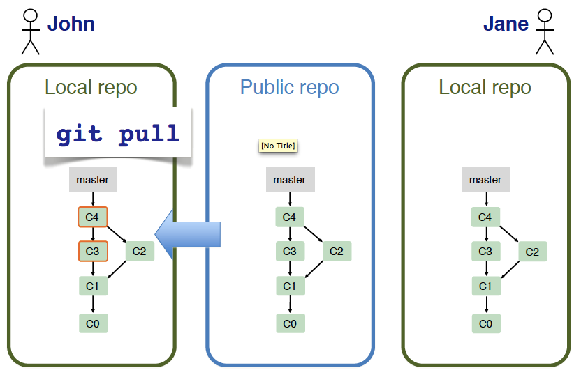

Slide 29
Git Hosting

Slide 30


Git Hosting
GitHub: https://github.com/
Git Only
Unlimited Free Public Repos
5 Free Private Repos (with Student Discount)
Unlimited Team Size
Issue Tracking + Pull Requests/Reviews + Wiki + Websites
BitBucket: https://bitbucket.org/
Git or Hg
Unlimited Free Public Repos
Unlimited Free Private Repos
Unlimited Team Size (with Student Discount)
Issue Tracking + Pull Requests/Reviews + Code Reviews

Slide 31
Git
CU CS GitLab: https://git.cs.colorado.edu/
Git Only
Unlimited Free Public Repos
Unlimited Free Private Repos
Unlimited Team Size
Issue Tracking + Pull Requests/Reviews + Wiki
Free and Open Source

